Slide 1
Lecture 9
WRITING AN ABSTRACT FOR YOUR RESEARCH PAPER

Slide 2
PLAN
DEFINITION AND PURPOSE OF ABSTRACTS
THE CONTENTS OF AN ABSTRACT

Slide 3
THE FUNCTION OF THE ABSTRACT
An abstract is a short summary of your (published or unpublished) research paper, usually about a paragraph (c. 6-7 sentences, 150-250 words) long. A well-written abstract serves multiple purposes:
an abstract lets readers get essence of your paper or article quickly, in order to decide whether to read the full paper;
an abstract prepares readers to follow the detailed information, analyses, and arguments in your full paper;
and, later, an abstract helps readers remember key points from your paper.

Slide 4
THE FUNCTION OF THE ABSTRACT
It’s also worth remembering that search engines and bibliographic databases use abstracts, as well as the title, to identify key terms for indexing your published paper. So what you include in your abstract and in your title are crucial for helping other researchers find your paper or article.

Slide 5
THE FUNCTION OF THE ABSTRACT
THE FUNCTION of an abstract is twofold. It summarises content and acts as an advertisement. An abstract is often the only permanent and public record of your research and must therefore be able to stand alone. It is likely to include the following elements:
background,
materials and methods,
results and conclusions.
Increasingly, journals and conferences specify that a 'structured abstract' should include headings such as these. Other abstracts may be more informal but should still be informative, complete, clear, precise and well structured.

Slide 6
A good abstract
A good abstract communicates the essential ideas in the work. It covers all the key points, is precise and accurate, logical and to the point. It is clearly and concisely written, and interesting. All this in the allocated 200 or 250 words is not easy. The most efficient way to deal with this problem is to adopt a systematic approach. The discipline imposed by a strict word limit, at first sight a source of difficulty, will probably help to clarify and communicate ideas accurately

Slide 7
Abstracts contain most of the following kinds of information in brief form
The body of your paper will, of course, develop and explain these ideas much more fully.

Slide 8
Here are the typical kinds of information found in most abstracts:
the context or background information for your research; the general topic under study; the specific topic of your research
the central questions or statement of the problem your research addresses
what’s already known about this question, what previous research has done or shown

Slide 9
Here are the typical kinds of information found in most abstracts:
the main reason(s), the exigency, the rationale, the goals for your research—Why is it important to address these questions? Are you, for example, examining a new topic? Why is that topic worth examining? Are you filling a gap in previous research? Applying new methods to take a fresh look at existing ideas or data? Resolving a dispute within the literature in your field? . . .
your research and/or analytical methods
your main findings, results, or arguments
the significance or implications of your findings or arguments.

Slide 10
do not cite references
Your abstract should be intelligible on its own, without a reader’s having to read your entire paper. And in an abstract, you usually do not cite references—most of your abstract will describe what you have studied in your research and what you have found and what you argue in your paper. In the body of your paper, you will cite the specific literature that informs your research.

Slide 11
STRUCTURE OF THE ABSTRACT
An abstract may be informal or structured. The 'structured abstract' was first proposed in 1987
by the Ad Hoc Working Group for Critical Appraisal of the Medical Literature, which suggested that authors should 'structure their abstracts so that key aspects of purpose, methods and results are reported in a partly controlled vocabulary and in a standardised format'.

Slide 12
Informal abstracts
Other journals have their own (generally shorter) structures or may not specify any particular structure.

Slide 13
CONTENT AND STYLE OF THE ABSTRACT
Title In addition to the four sections of the abstract itself, the title also plays an important part. If the abstract acts as an advertisement, the title is even more important. Many more people will read the title than will read the abstract, just as more people read the abstract than read the whole paper. Fewer and simpler words are more likely to convey the meaning of the paper. Of course, the meaning of the entire article cannot be expressed in the title but the main points should be included. If the subject is suitable, the cause, setting and result of the study should be described. Any statement made in the title must be supported by data within the text

Slide 14
CONTENT AND STYLE OF THE ABSTRACT
Background The abstract should start with a statement about the importance or purpose of the study (with perhaps a brief comment on previous work in the field). The hypothesis and benefits of the study should also be described, although if space is short these could be included in the main text.

Slide 15
CONTENT AND STYLE OF THE ABSTRACT
Methods The setting, study population, selection of subjects for the study and research design should also be included. How were cases (patients or other sources of data) selected? What intervention was used? How were data collected? Over what period of time? If space allows, the analytical techniques and statistical tests can also be described sufficiently to allow the reader to assess the rigour of the methods.

Slide 16
CONTENT AND STYLE OF THE ABSTRACT
Results This is likely to be the longest section. Give the number and type of observations made during the study and summarise the key findings, including details of any statistical test results. Precision is important. For example, rather than stating that 'the two groups differed significantly', say by how much they differed and how significant the result was. If necessary, prune the methods and expand the results.

Slide 17
CONTENT AND STYLE OF THE ABSTRACT
Conclusion This section may be expendable if space is very short. In any case, it should be kept brief. State whether the hypothesis was proven, and highlight the importance of the work. The conclusions should consist of a generalisation from the specific results to the wider world and must follow directly from the results presented.

Slide 18
KEY POINTS
The abstract should be written for the purpose, not as an extract from the main paper, a technique which inevitably results in inadequate information on some aspects of the work and excessive detail elsewhere. The abstract should be written from scratch, as a summary of the work described in the paper, not as a series of extracts from the paper. For both title and abstract, words should be chosen carefully. Where a paper is to be published in a journal, the text should be considered from the point of view of someone trying to retrieve information from a bibliographic database. After writing the abstract, it is often a good idea to leave it aside for a few days and then subject it to further review and editing. Even if the abstract complies with the specified word limit, the text may well benefit from editing. Every sentence should be critically examined, each word analysed for its value to the meaning. It is astonishing how many of the sentences which have been agonised over can be drastically shortened or even cut out altogether.

Slide 19
PITFALLS, PROBLEMS AND GOLDEN RULES
The most important rule is to follow the rules. If the conference or journal asks for abstracts not exceeding 200 words it is unacceptable to submit 250 words or even 201. If the rules specify a structure with particular headings, the style should be followed exactly. If there is a special format, it should be used. If the width of the margin, the type size or the font are specified these should be used. If the abstract for a conference has to be submitted by a particular date, the date should be honoured. There is no point in an author producing a beautifully written abstract only for it to be rejected because it fails to meet some apparently trivial criterion. Perhaps the most common failing in an abstract is to be imprecise. The statement that 'results will be presented' merely creates the suspicion that the study is unfinished, as does 'the implications will be discussed'. It is inexcusable to write such phrases in an abstract submitted to a journal alongside the full paper and they should also be avoided in conference abstracts. When the abstract is written the results and their implications should be clear

Slide 20
SO
Authors should remember how many people may read the abstract and how few will read the full text or hear the presentation. Readers deserve to receive information in a clear and interesting way. It is not as easy as it seems at first sight, but it is an art that can be perfected with practice and attention to detail.

Slide 21
NICCOLÒ PIANCIOLA The Collectivization Famine in Kazakhstan, 1931–1933 in Harvard Ukrainian Studies , Fall 2001, Vol. 25, No. 3/4 (Fall 2001), pp. 237-251
Cameron, Sarah Isabel The Hungry Steppe: Soviet Kazakhstan and the Kazakh Famine, 1921-34

Slide 22
Robert Keirle Meat and its Meaning: Foodways in Late Medieval London, 1350-150 0Best undergraduate dissertations of
2019

Slide 23
CHOOSING VERB TENSES WITHIN YOUR ABSTRACT
The social science sample (Sample 1) below uses the present tense to describe general facts and interpretations that have been and are currently true, including the prevailing explanation for the social phenomenon under study. That abstract also uses the present tense to describe the methods, the findings, the arguments, and the implications of the findings from their new research study. The authors use the past tense to describe previous research.

Slide 24
The humanities sample
The humanities sample (Sample 2) below uses the past tense to describe completed events in the past (the texts created in the pulp fiction industry in the 1970s and 80s) and uses the present tense to describe what is happening in those texts, to explain the significance or meaning of those texts, and to describe the arguments presented in the article.

Slide 25
The science samples
The science samples (Samples 3 and 4) below use the past tense to describe what previous research studies have done and the research the authors have conducted, the methods they have followed, and what they have found. In their rationale or justification for their research (what remains to be done), they use the present tense. They also use the present tense to introduce their study (in Sample 3, “Here we report . . .”) and to explain the significance of their study (In Sample 3, This reprogramming . . . “provides a scalable cell source for. . .”).

Slide 26
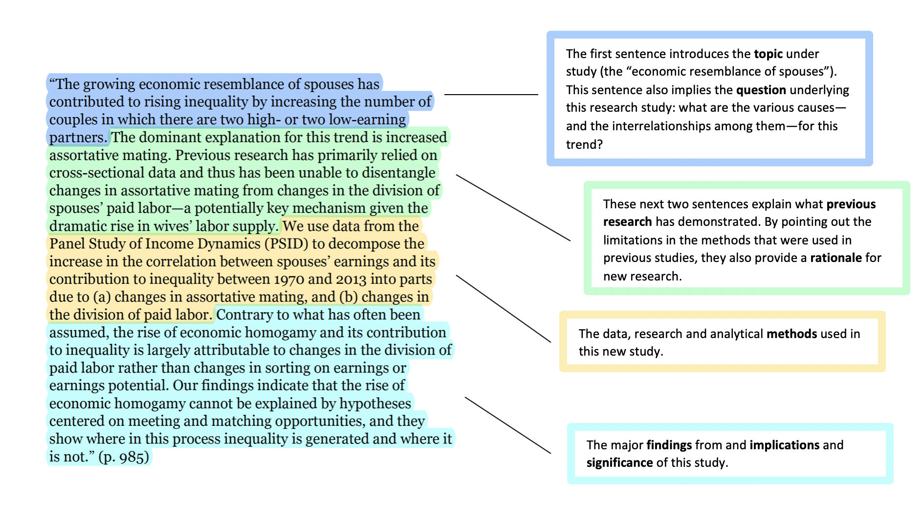
Gonalons-Pons, Pilar, and Christine R. Schwartz. “Trends in Economic Homogamy: Changes in Assortative Mating or the Division of Labor in Marriage?” Demography, vol. 54, no. 3, 2017, pp. 985-1005.

Slide 27
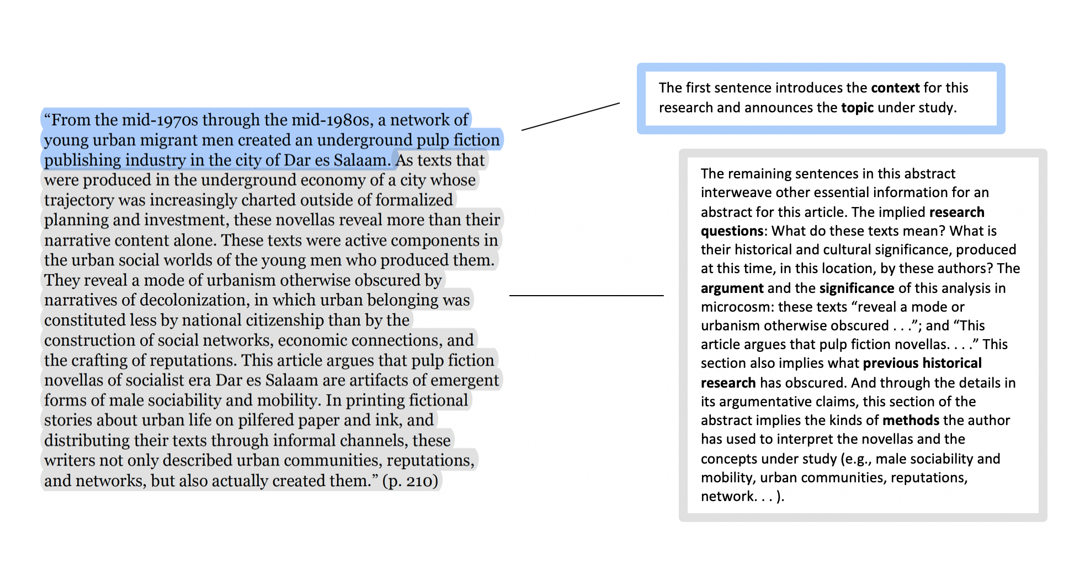
Emily Callaci. “Street Textuality: Socialism, Masculinity, and Urban Belonging in Tanzania’s Pulp Fiction Publishing Industry, 1975-1985.” Comparative Studies in Society and History, vol. 59, no. 1, 2017, pp. 183-210.

Slide 28
"Сопротивление идеологии, подчинение языку": мастерская писателя Г. Мусрепова в условиях советской политической цензуры, 1928-1964 гг.
This paper examines how under the control of strong censorship some of Musrepov’s literature works has been published despite of a seditious in nature. The author argues that although G.Musrepov was a reputable soviet writer, and the materials given in the article proves that, he worked at the meeting point of resistance and subjugation: resistance to ideology, subjugation to language. Literary analyses of the Musrepov’s short three stories shows that under the strictest control and actively expressed interest of the authorities to the writers’ creative activities, his mastery and incompetence of censors allowed him to avoid the lot of the prohibited works.

Slide 29
Putting the soviet history over subjective, micro experience: Kazakh women’ personal narratives as the evidence of the Early Soviet epoch hidden part, 1920-1930
Abstract
This paper through analysis of Kazakh women personal narratives (autobiographies, memoirs, correspondence, and life stories) examines the interior world of women lived in the epoch of soviet modernization. The author used wide variety of narratives: published in Soviet and post-Soviet times, as well as unpublished memoirs and family histories, diaries, and personal correspondence stored in the personal funds of the Central State Archive of the Republic of Kazakhstan, also the transcripts of interviews with the descendants of women, and letters, photos provided from family archives. They were written by Kazakh women of different social strata - members of new party elite, wives of intellectuals and new party elite, the scientific and artistic intelligentsia and ordinary people. I argue that personal narratives should be used as evidence that allow us to articulate a number of Soviet life features not contained in archival documents. While archival records indicate the specific actions of the Bolsheviks aimed for constructing a new Kazakh woman, emancipated and active, full-fledged member of society or the implantation of soviet family-marriage system, getting access to education and health services, personal narratives help us to recovery the hidden Soviet past, the past as experienced by ordinary people, the influence of the soviet regime and Campaigns of terror on family relations, emotions, beliefs, moral choices. Personal narratives have great significant for study, because stories that women tell are never simply individual, they allow to show the diversity of human experiences in Soviet society, that ultimately put the personal into the historical context.
Key words: Kazakh women, personal narratives, soviet modernization, institutional violence, gender order, interior world, family relations, emotions, labor, power, cathexis

Slide 30
Virginia MartinKazakh Chinggisids, land and political power in the nineteenth century: a case study of Syrymbet
This article tells the story of a piece of land called Syrymbet, which was the patrimony of Middle Horde khans in the eighteenth century, but which had shrunk over the course of the nineteenth century until nothing was left of it but a small plot of privately claimed property. Over this period, which saw the erection of an imperial legal-administrative structure in the steppe, the nomadic political culture and the nature of nomadic land claims within it evolved, as Chinggisids, the traditional elite caste in Kazakh society, struggled to defend their land rights, social status and political power based in patronage. Based on a close reading of archival and published sources, this micro-history traces the actions of Syrymbet’s Chinggisid claimants Aighanym and her son Chinggis, from the 1820s to the 1890s, and argues that their adaptation to Russian rule facilitated their downfall, while new elites emerged to play their roles in a transformed nomadic society.
Keywords: Kazakh Chinggisids; Syrymbet; nomadic political culture; micro-history; Middle Horde steppe; nineteenth-century Russian Empire

